Slide 1

LawyerMatch:
Your Perfect Legal Partner

Slide 2
ORIGINAL DATA
Lawyer Names | Information
Anay Ahluwalia | Anay Ahluwalia has 20 years of experience in Corporate Law, Consumer Protection Law, and Labor Law…. Her Client Demographics is Large Corporations.
Arnav Dubey | Arnav Dubey has 29 years of experience in Intellectual Property Law, Criminal Law, and Tax Law…...Her Client Demographics is Small Businesses.
Lavanya Lalla | Lavanya Lalla has 15 years of experience in Human Rights Law, Civil Law, and Family Law…... His Client Demographics is Large Corporations.
Armaan Khosla | Armaan Khosla has 11 years of experience in Constitutional Law, Media and Entertainment Law, and Real Estate Law…..Her Client Demographics is Large Corporations.
Advik Chaudry | Advik Chaudry has 8 years of experience in Human Rights Law, Constitutional Law, and Human Rights Law. ...Her Client Demographics is Individuals.

Slide 3
Anay Ahluwalia has 20 years of experience in Corporate Law, Consumer Protection Law, and Labor Law. He has a Client Feedback of 5.0 out of 5.0…….. Her Client Demographics is Large Corporations.
Anay Ahluwalia has 20 years of experience
Corporate Law, Consumer Protection Law, and Labor Law
Corporate Law, Consumer Protection Law, and Labor Law
He has a Client Feedback of 5.0 out of 5.0
Her Client Demographics is Large Corporations

Slide 4
DATA DESCRIPTION
LAWYERS NAME | Specify the lawyer's name for the column
EXPERIENCE | Indicate the lawyer's years of experience
PRACTICES | The categories in which the lawyer specializes
FEEDBACK | The feedback the lawyers have received is out of 5
JURISDICTION | The jurisdiction in which the lawyer works
RATE | Rate of the lawyer in USD

Slide 5
DATA DESCRIPTION
DISPOSAL TIME | The average time taken by the lawyer to complete the case
LANGUAGE | The languages known by the Lawyer
CITY | The city in which the lawyer practices
COMPANIES | The companies in which the lawyer works
SIZE OF THE FIRM | The size of the companies lawyer works for
PROBONO | Lawyers who provide poor and underprivileged clients with valuable legal advice and support without seeking any professional fee.

Slide 6
LAWYERS NAME | EXPERIENCE | PRACTICES | FEEDBACK | JURISDICTION
Anay Ahluwalia | 20 | ['Corporate', 'Consumer', 'Protection', 'and', 'Labor', 'Law'] | 5 | Supreme Court
Arnav Dubey | 29 | ['Intellectual', 'Property', 'Criminal', 'and', 'Tax', 'Law'] | 2 | Specialized Court
Lavanya Lalla | 15 | ['Human', 'Rights', 'Civil', 'and', 'Family', 'Law'] | 5 | Specialized Court
Armaan Khosla | 11 | ['Constitutional', 'Media', 'and', 'Entertainment', 'and', 'Real', 'Estate', 'Law'] | 2 | Specialized Court
Advik Chaudry | 8 | ['Human', 'Rights', 'Constitutional', 'and', 'Human', 'Rights', 'Law'] | 2 | Supreme Court

Slide 7
RATINGS | DISPOSAL TIME | LANGUAGE | CITY | COMPANIES | SIZE OF THE FIRM | PROBONO
420.6850079 | 117.6959388 | ['Telugu', 'Hindi', 'Hindi'] | Hyderabad | Saini PLC | Large Corporations | 1
435.6630627 | 119.0003962 | ['Urdu', 'Kannada', 'Tamil'] | Delhi | Sarna-Contractor | Small Businesses | 0
236.7982296 | 93.85126198 | ['Gujarati', 'Kannada', 'Tamil'] | Delhi | Gade-Cheema | Large Corporations | 1
90.20295603 | 89.82727368 | ['Punjabi', 'Telugu', 'Tamil'] | Kolkata | Brahmbhatt-Konda | Large Corporations | 1
247.0016648 | 105.4598971 | ['Malayalam', 'Odia', 'Urdu'] | Bangalore | Barad PLC | Individuals | 1

Slide 8
CATEGORY WISE KEYWORDS DATABASE
CORPORATE-
Firm Risk Board Share Stock Brand Trade Legal Board Profit Market
Asset…..Investment Securities Capitalism Divestment Net income
Regulation
CONSUMER PROTECTION-
User Laws Buyer Legal Legal Fraud Client Patron Rights Safety Shopper
….Average privacy Digital consumer Impulse Consumer behavior
LABOUR LAW-
Law Income Rights Unions Laborer Employee Employer Workforce Salary
reforms movement shortage activism Labor protests
INTELLECTUAL PROPERTY-
IP law Branding Invention Licensing Royalties Licensing Ownership ….litigation Patent application Copyright duration Trademark attorney
CRIMINAL LAW-
Gang Jury Bail Rape Gang Jury Bail Crime Trial Theft Fraud Arson Alibi Judge ……Booking Offense Justice Suspect Witness Defense

Slide 9
FLOWCHART

Slide 10
QUERY
DATA
STEMMING
COUNT VECTORIZATION
TFIDF
SIMILARITY
SIMILARITY
TEMPORARY CATEGORY
TEMPORARY CATEGORY
MAIN CATEGORY
INFORMATION
QUERY
SUBSET
FINAL OUTPUT

Slide 11
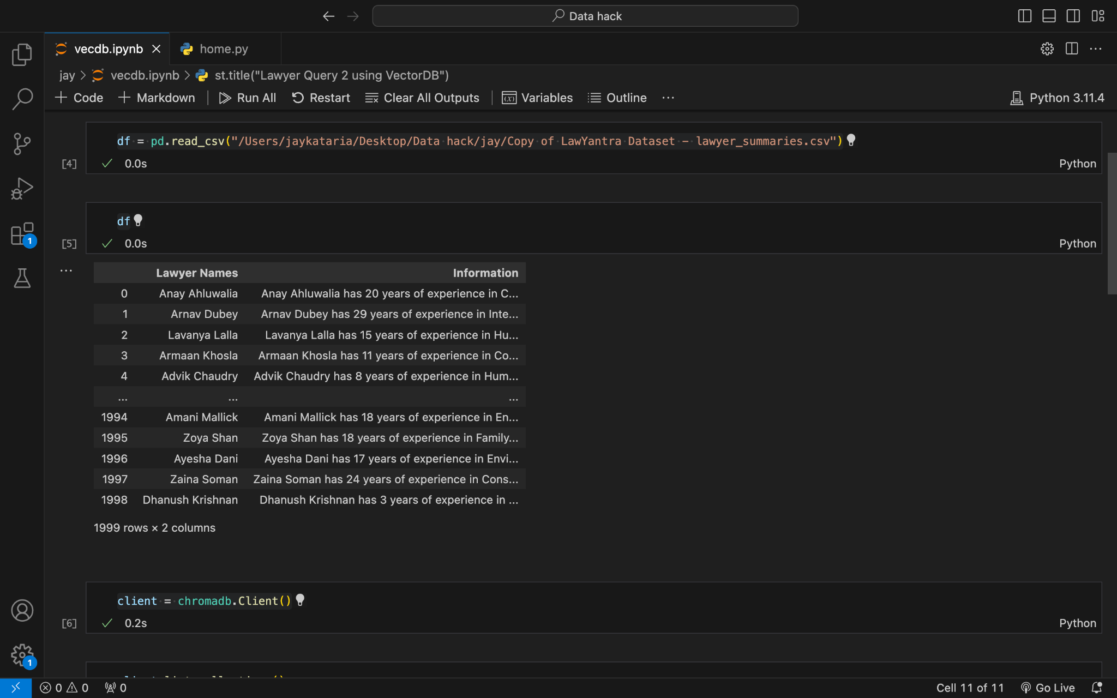
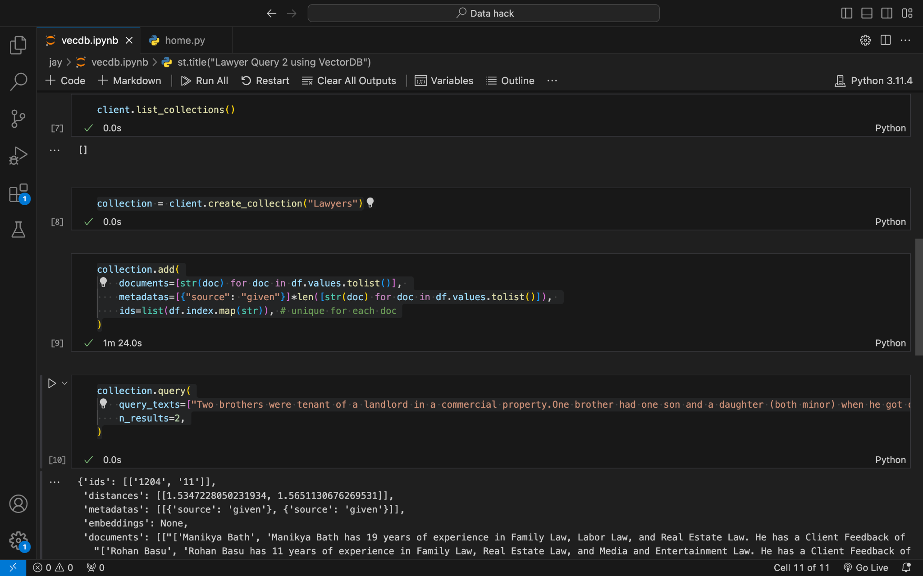

Slide 12
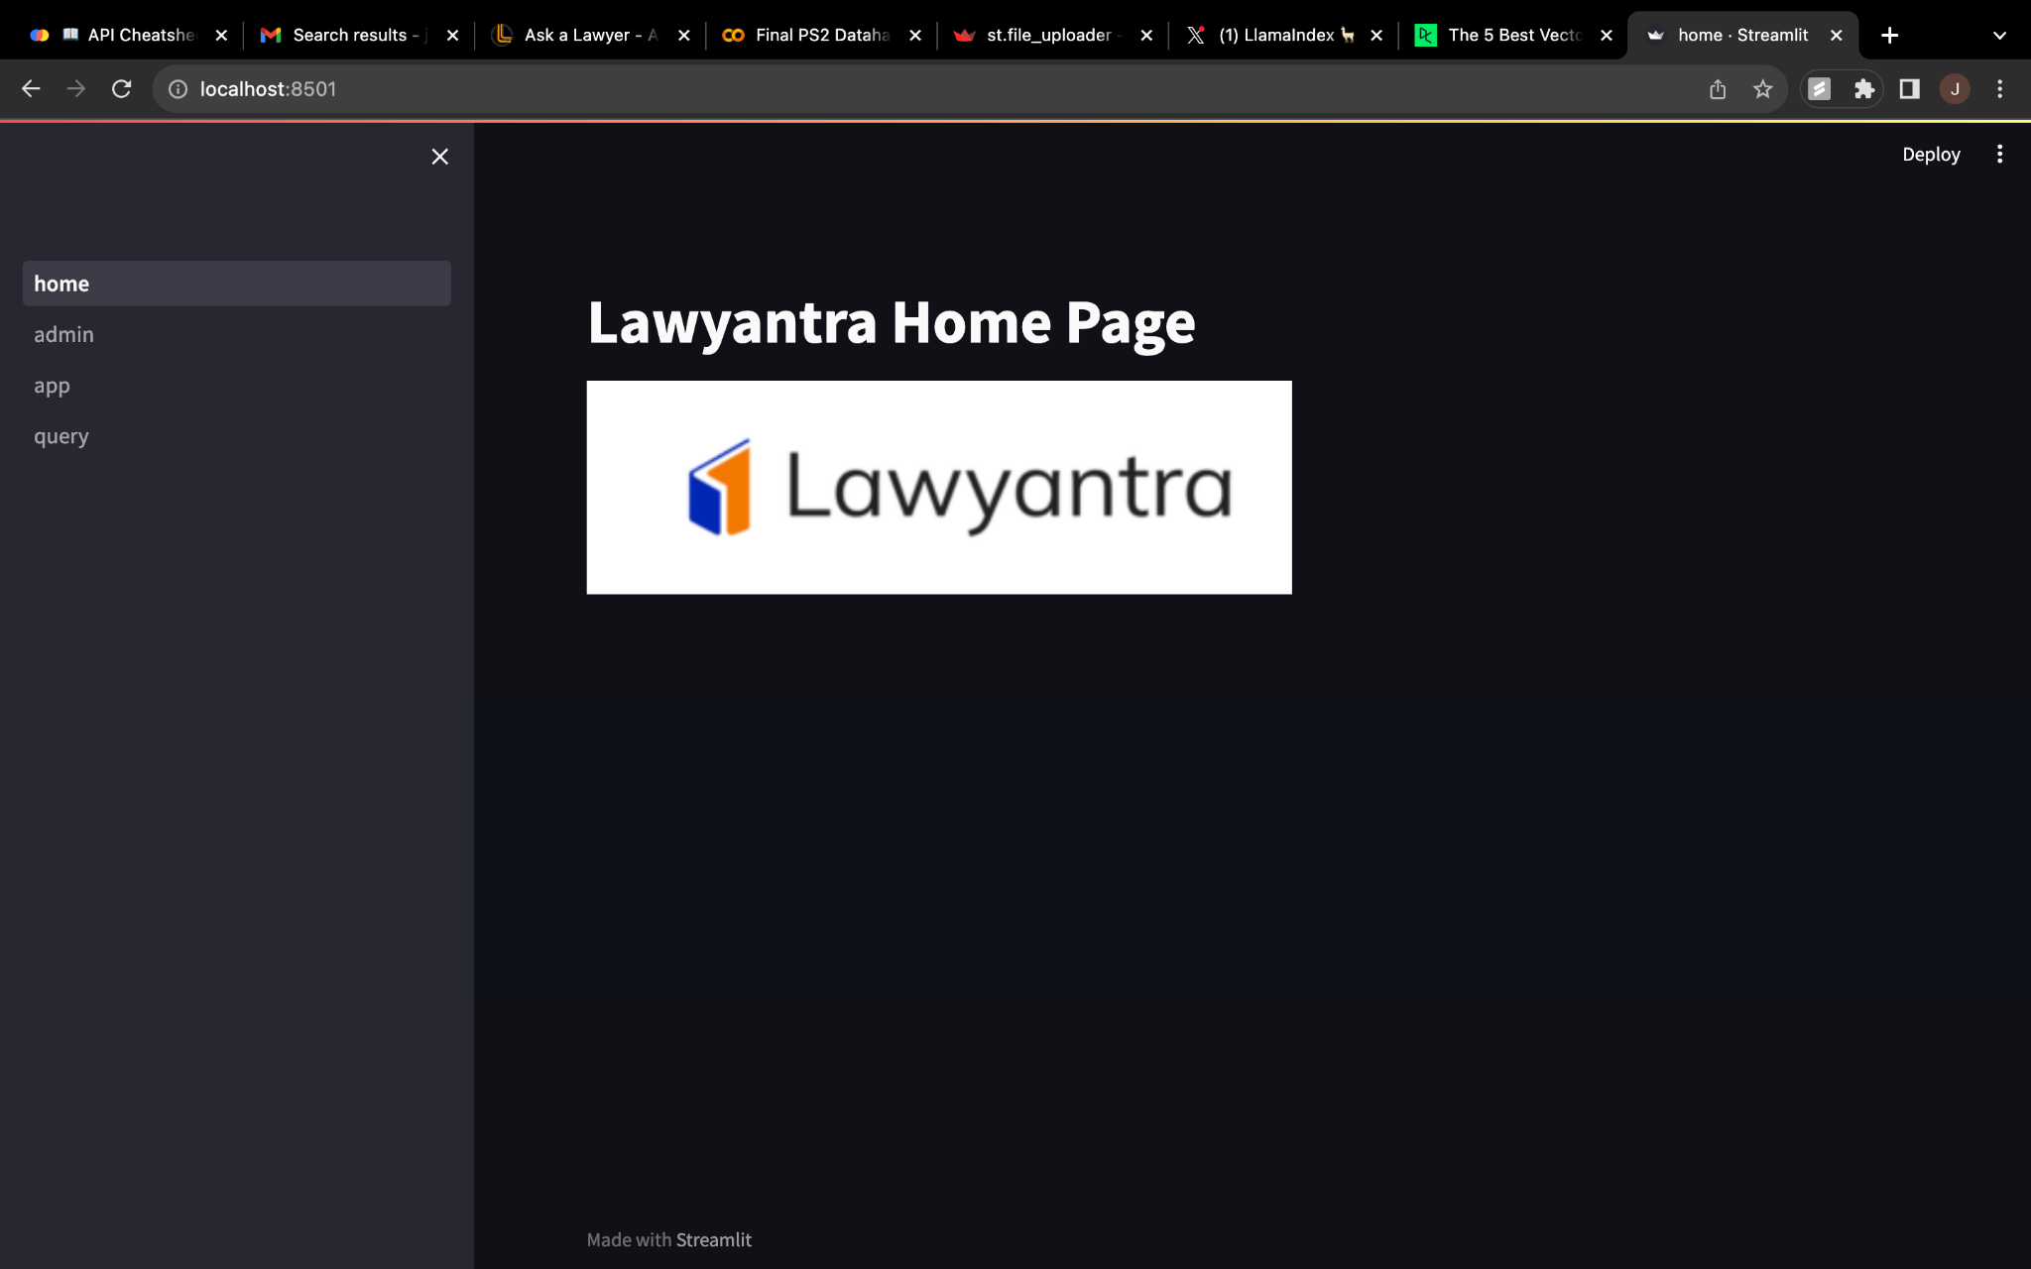
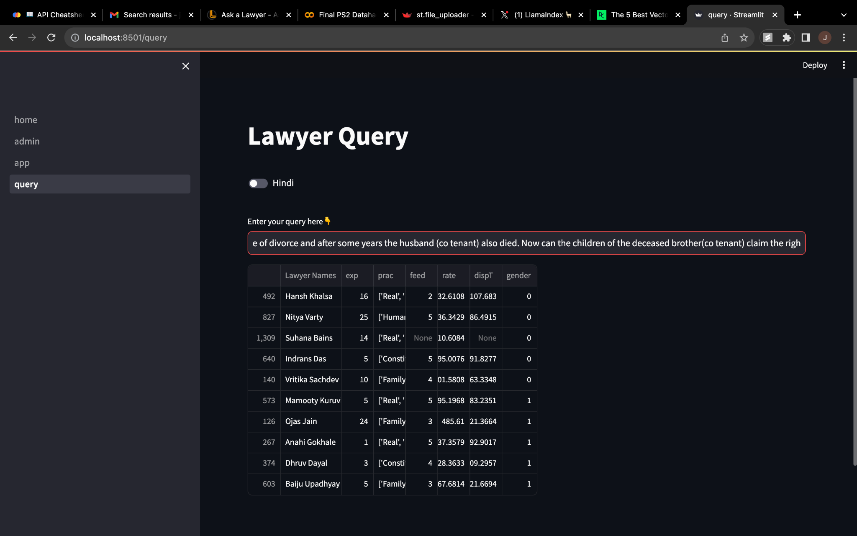
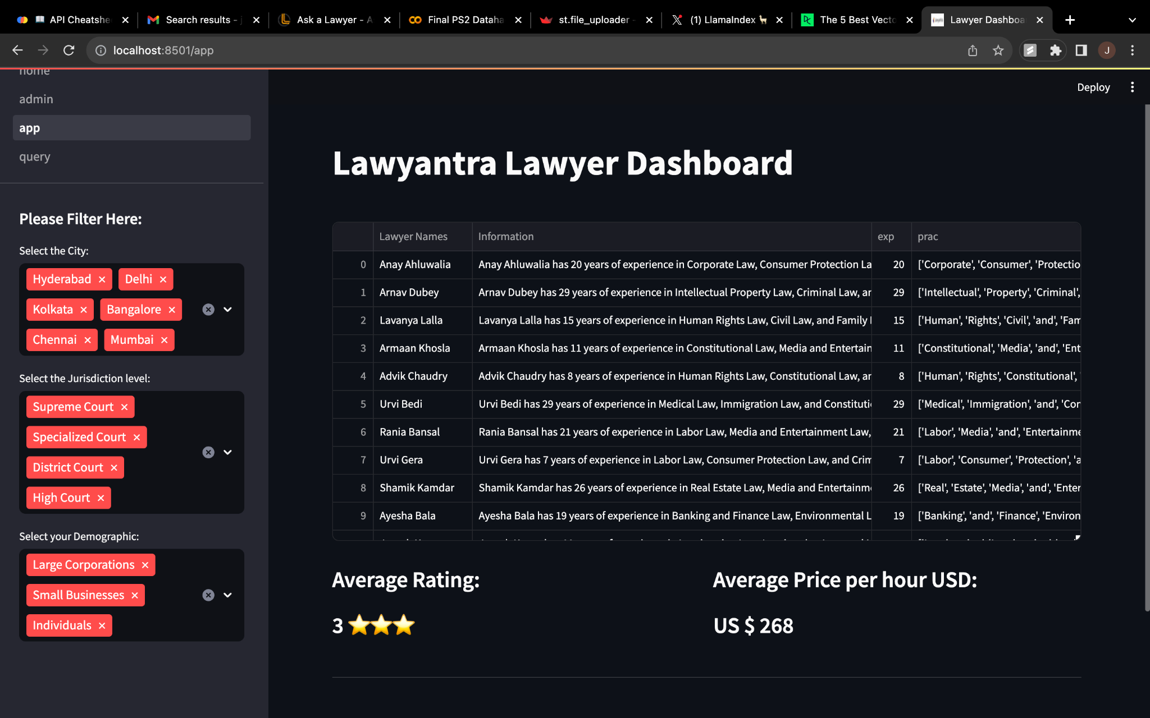
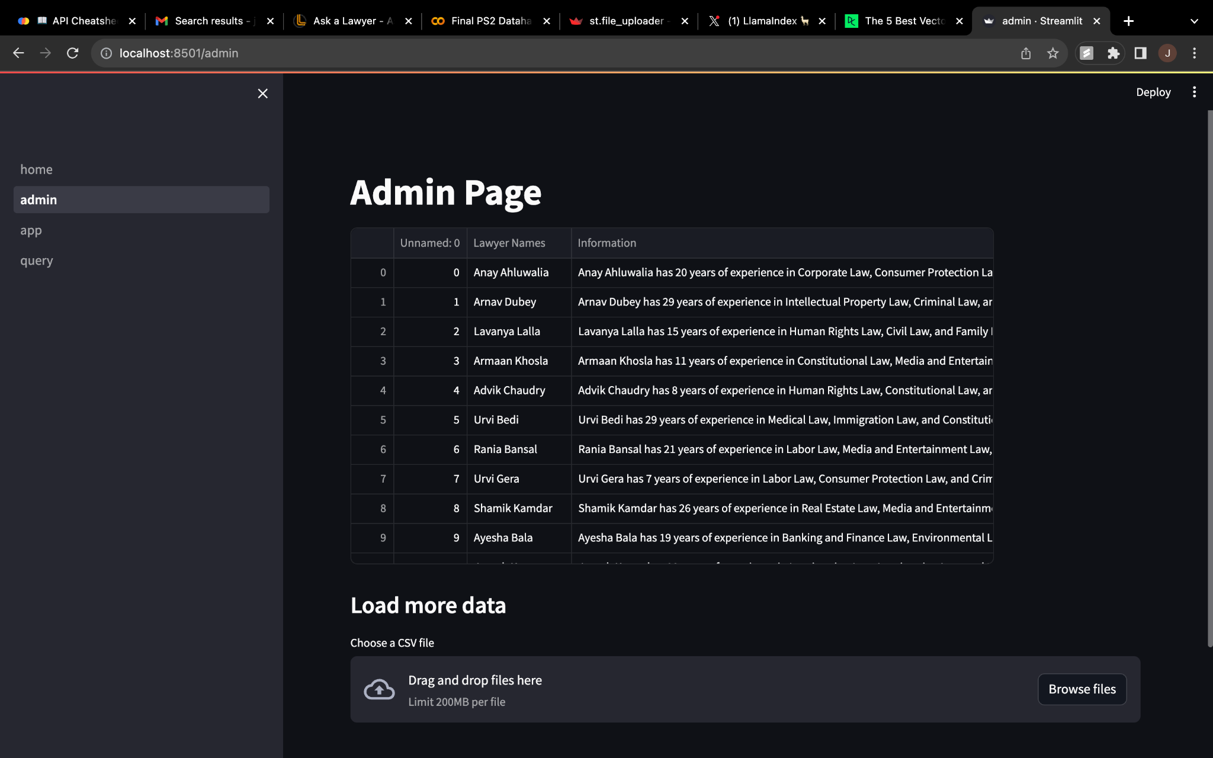
The slide title goes here!
Do you know what helps you make your point clear?
Lists like this one:
They’re simple
You can organize your ideas clearly
You’ll never forget to buy milk!
And the most important thing: the audience won’t miss the point of your presentation

